Slide 1
Availability of Street-Level Supports for Walking — US Virgin Islands, 2016

Slide 2
Outline
Background
Methods
Results
Potential Action Steps

Slide 3
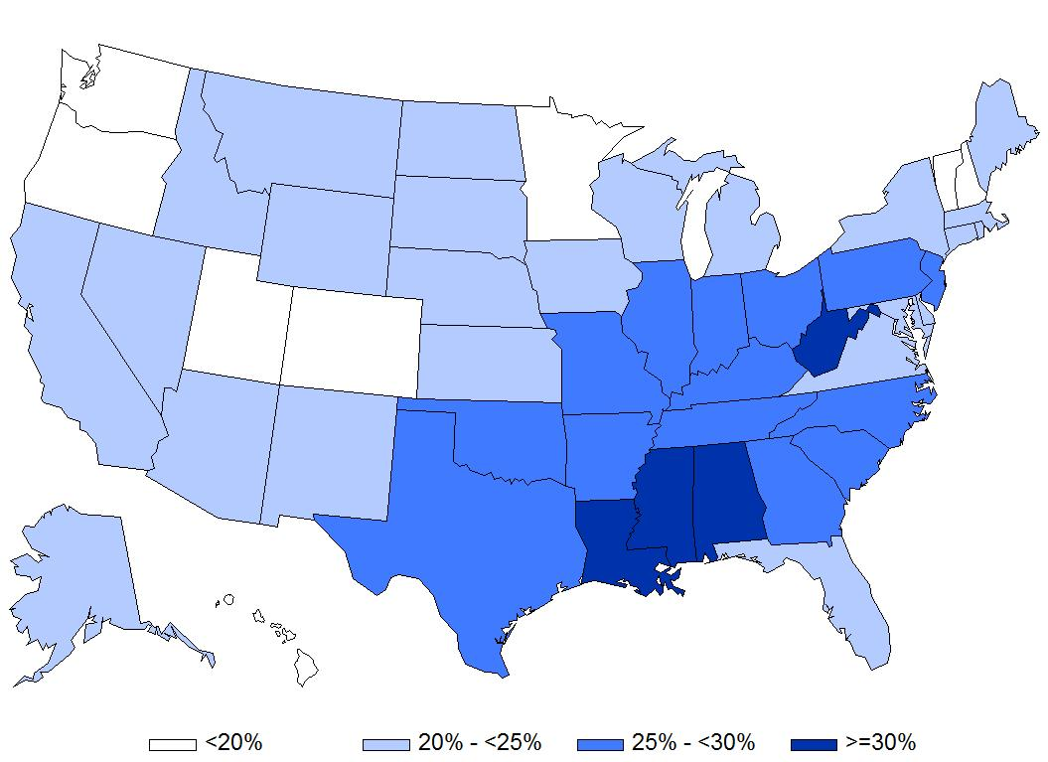
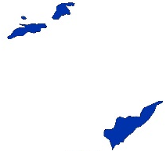
Prevalence of Physical Inactivity
31.8%
Source: Behavioral Risk Factor Surveillance System, 2010

Slide 4
Aims
Conduct an observational assessment of street-level supports for walking and physical activity
  Generate representative estimates of features across the territory
Identify potential action steps that could be taken to improve walkability in the territory

Slide 5
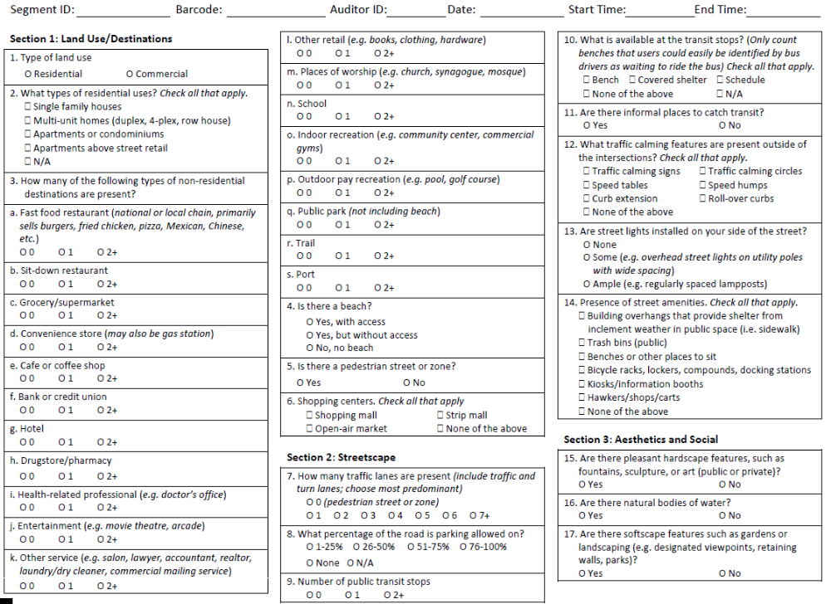
Audit Tool
Modified Microscale Audit of Pedestrian Streetscapes (MAPS)
  Added several locally relevant items
  46 items
Sections:
  Land use & destinations
  Streetscape
  Sidewalks & bike paths
  Aesthetics
  Street crossings

Slide 6
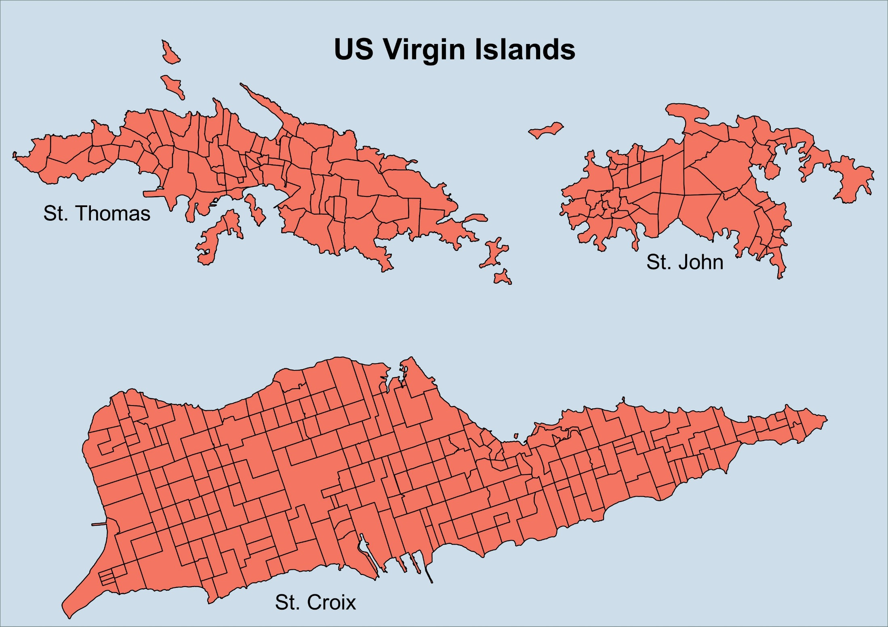
Total:
336 Estates

Slide 7
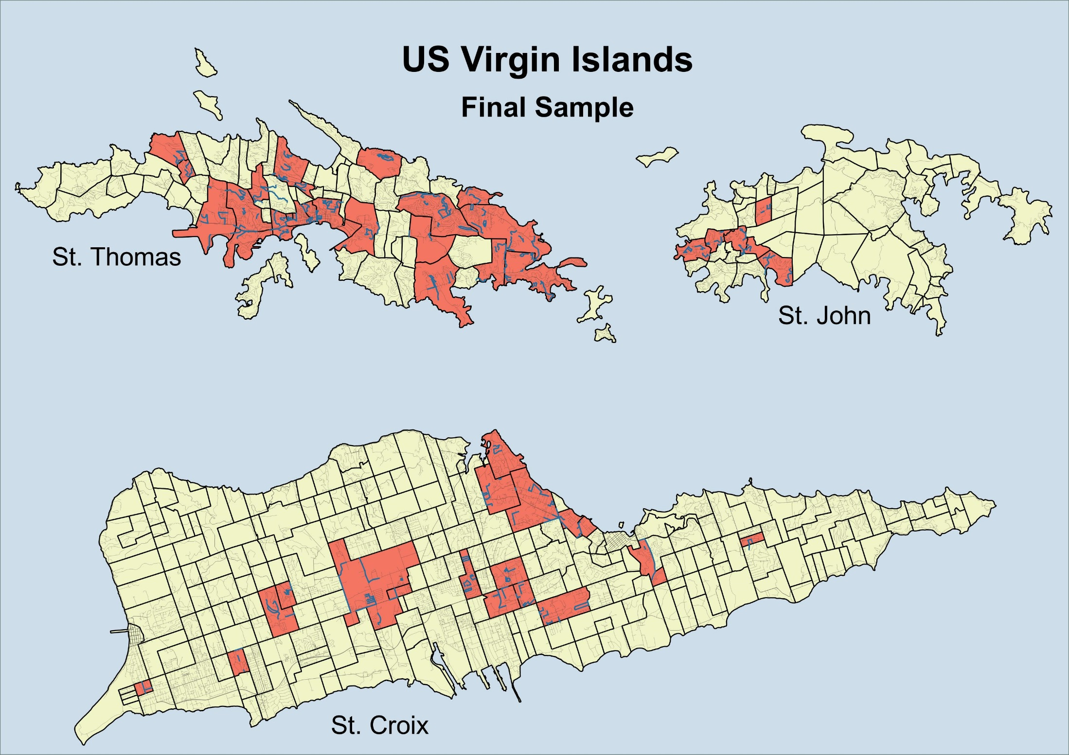
46 Estates
1550 Street Segments
99.2 km (16.2%)

Slide 8
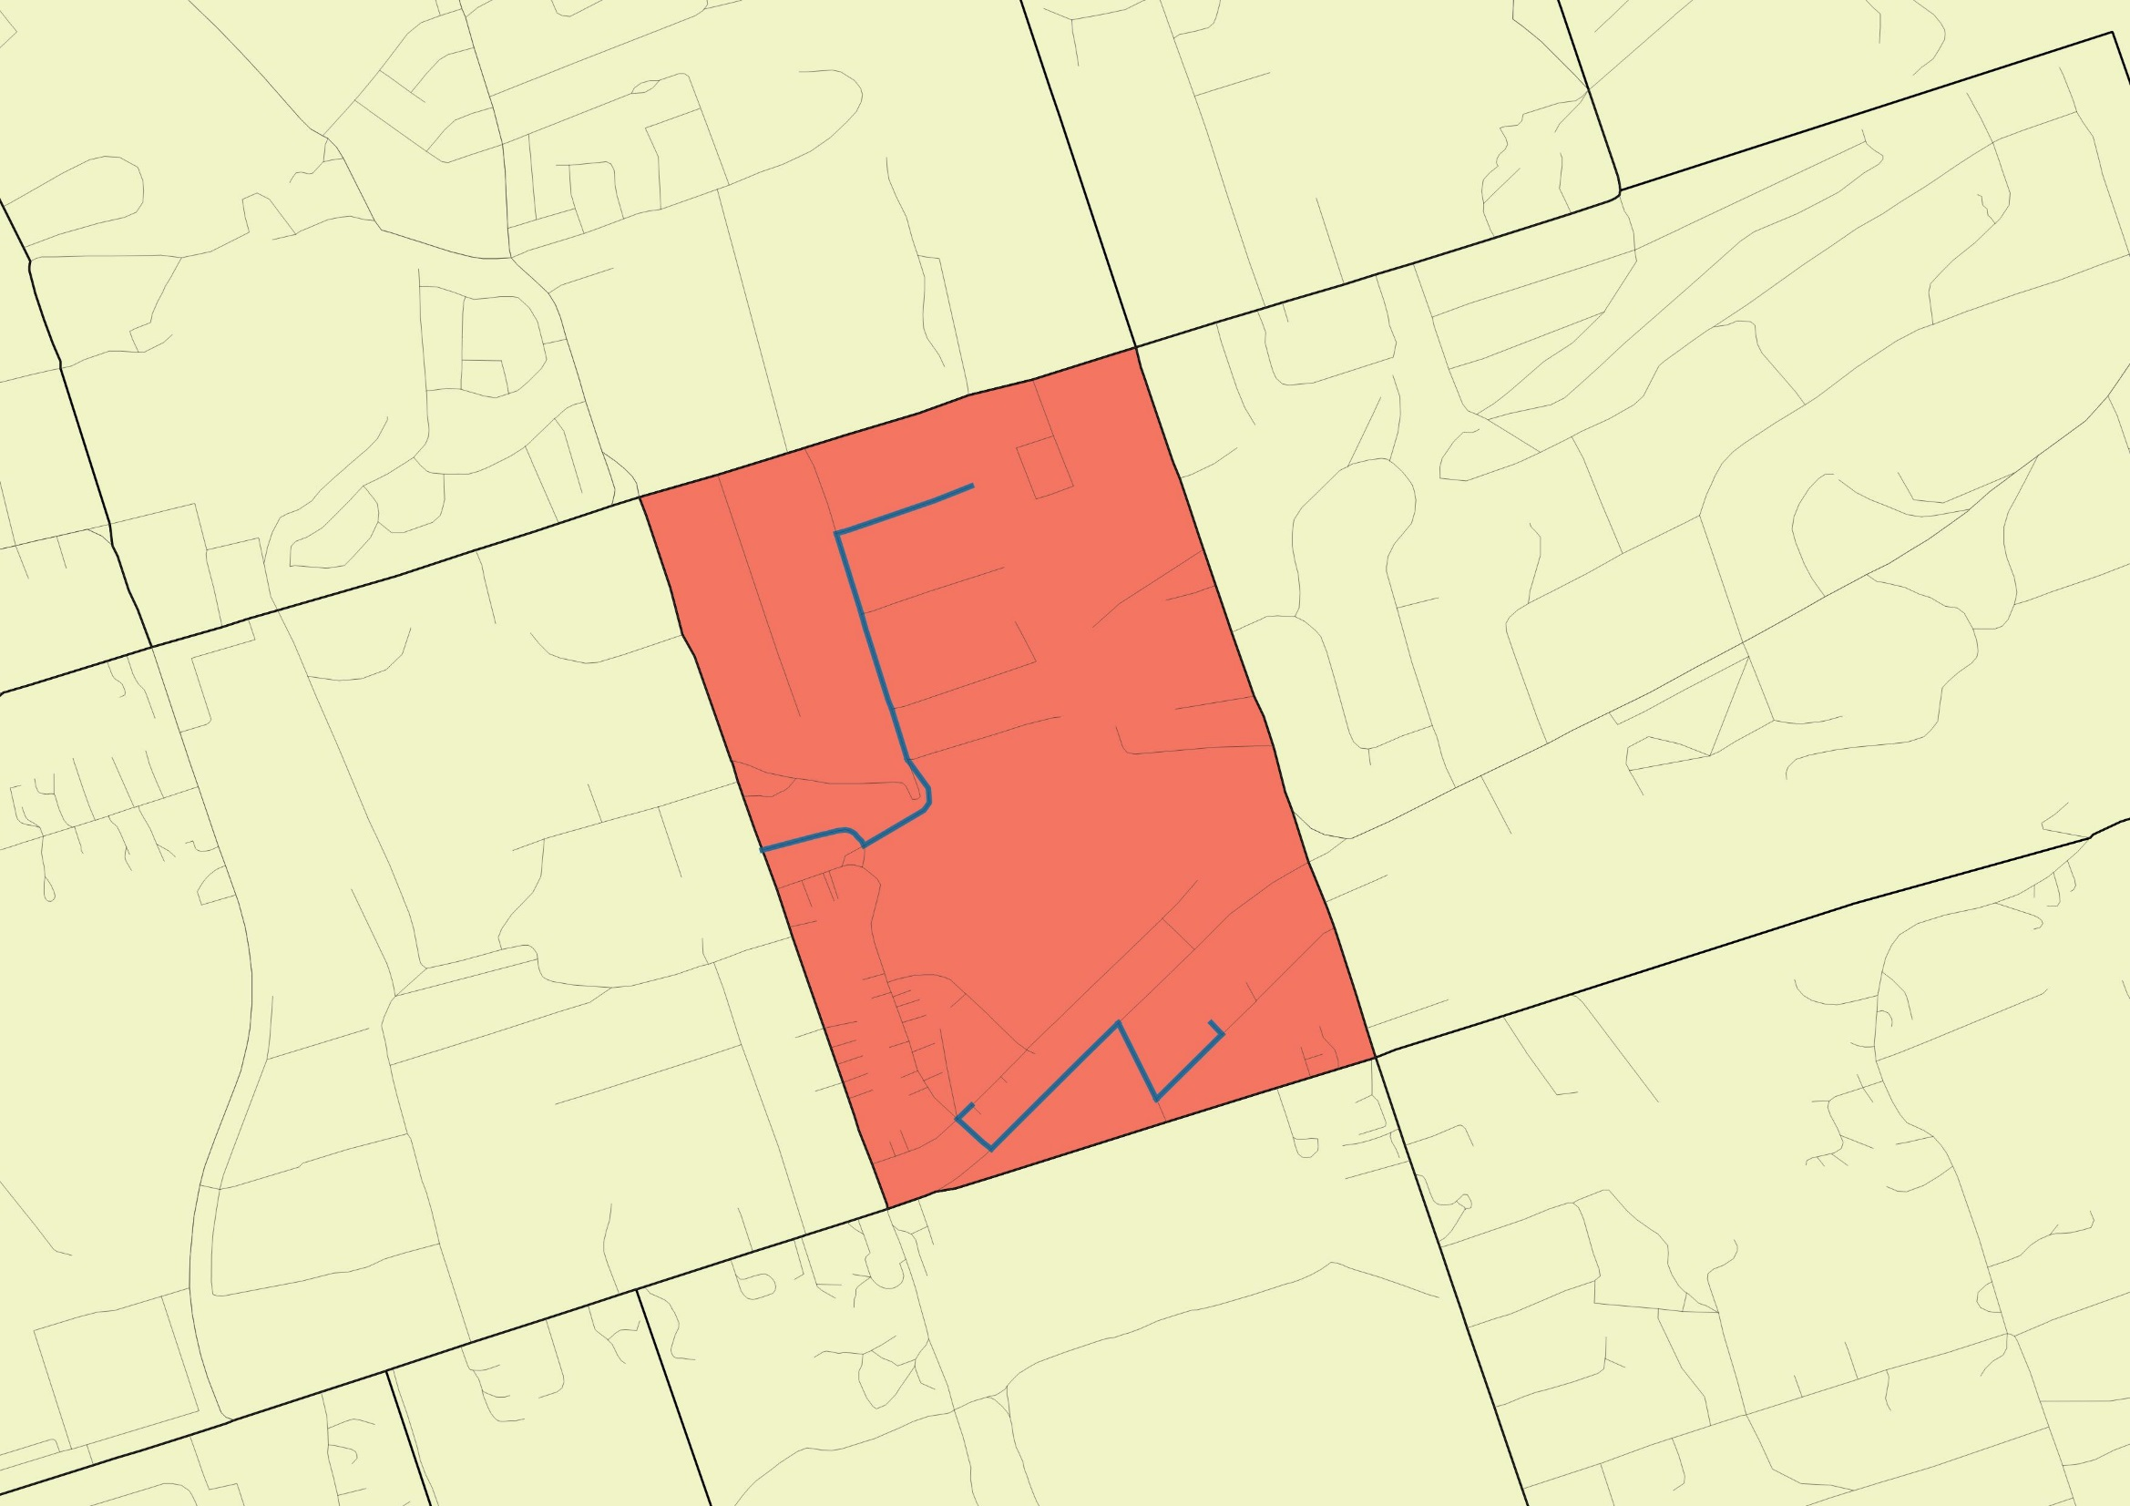

Slide 9
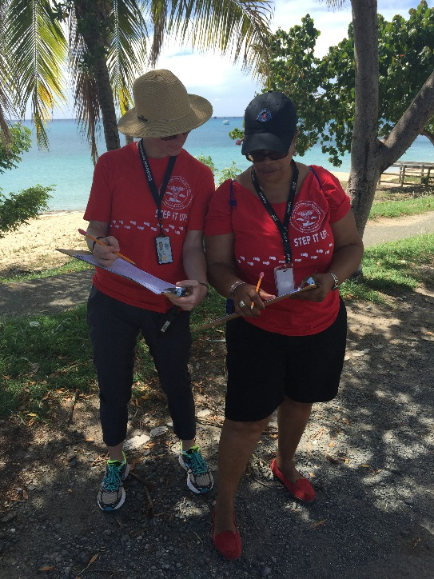
Data Collection
Trained 26 volunteers from the USVI Department of Health
Teams of two people
  CDC
  DOH
Step It Up! shirts provided by the USVI Department of Health
Completed in 12 days

Slide 10
Key Results

Slide 11
Characteristics of Audited Street Segments, by Island
 | Unweighted |  |  |  | Weighted by Street Length
 | n | (%) | km | (%) | km | (%)
Total | 1114 | - | 94.6 | - | 1156 | -
Island
St. Croix | 348 | (31.2%) | 34.6 | (36.5%) | 602 | (52.1%)
St. John | 132 | (11.9%) | 7.7 | (8.1%) | 61 | (5.3%)
St. Thomas | 634 | (52.3%) | 52.3 | (55.3%) | 492 | (42.6%)

Slide 12
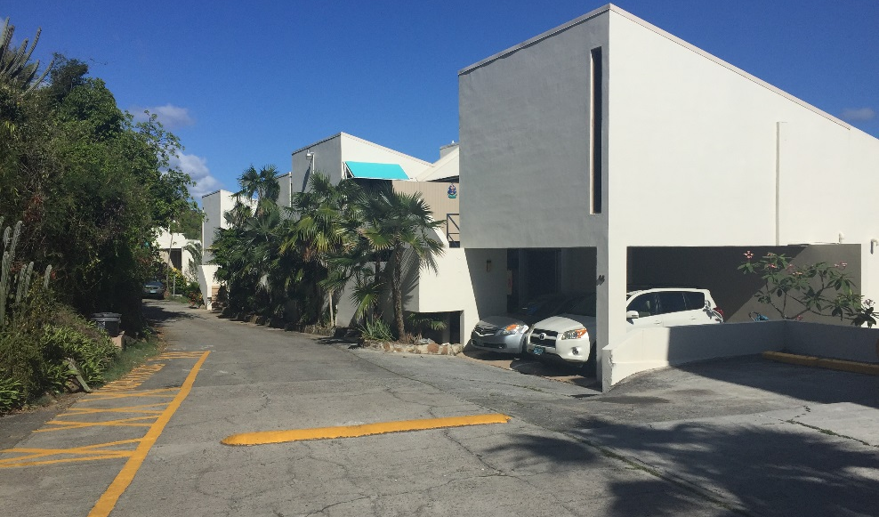
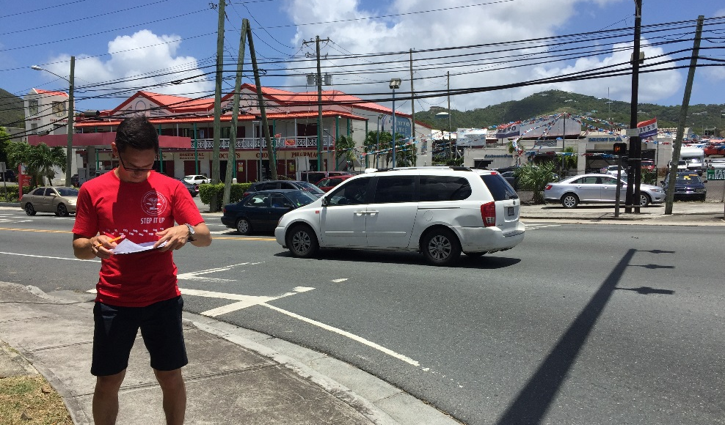
Type of Land Use
Residential only:
85.5%
Mixed use:
3.1%
Commercial only:
11.5%

Slide 13
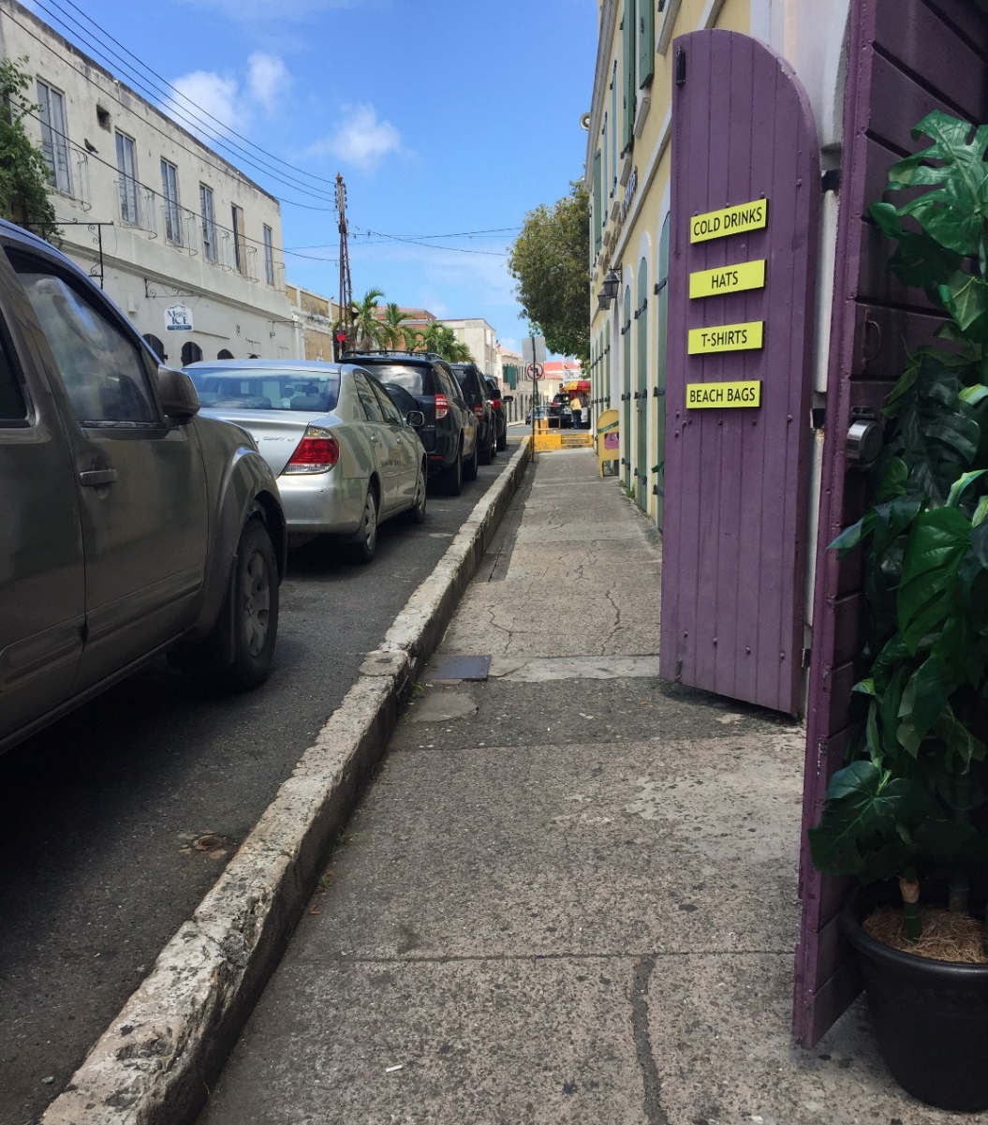
Number of Destinations
None:
78.2%
One to two:
13.2%
More than two:
8.6%

Slide 14
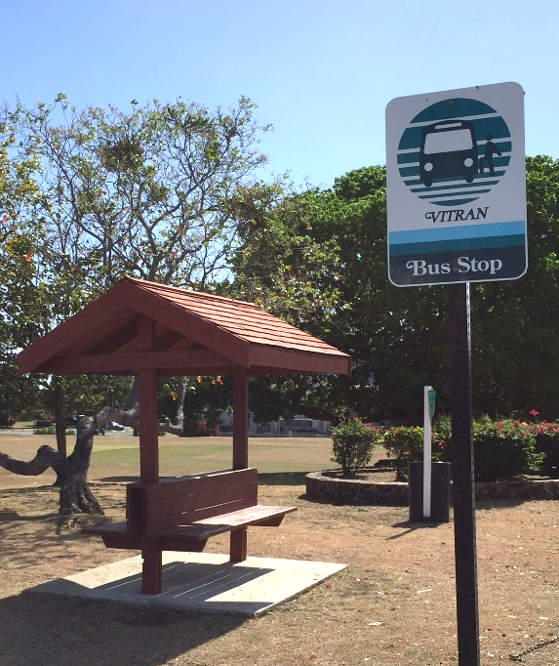
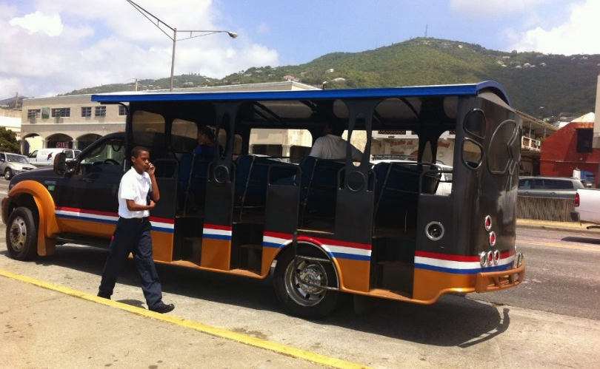
Access to Public Transit
Formal stop:
4.8%
Informal stop:
8.8%
Any stop:
10.7%

Slide 15

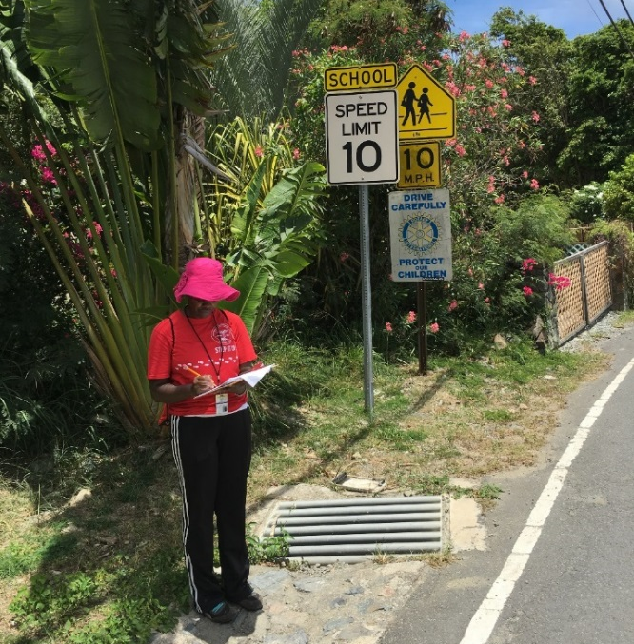
Traffic Calming Features
At least one*:
27.5%
None:
72.5%
* Includes traffic calming signs, traffic circles, speed tables, speed humps, and curb extensions

Slide 16
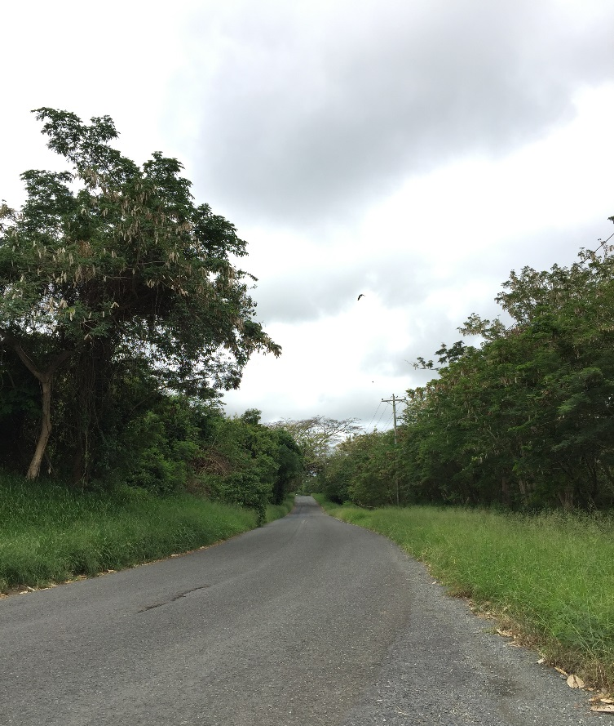
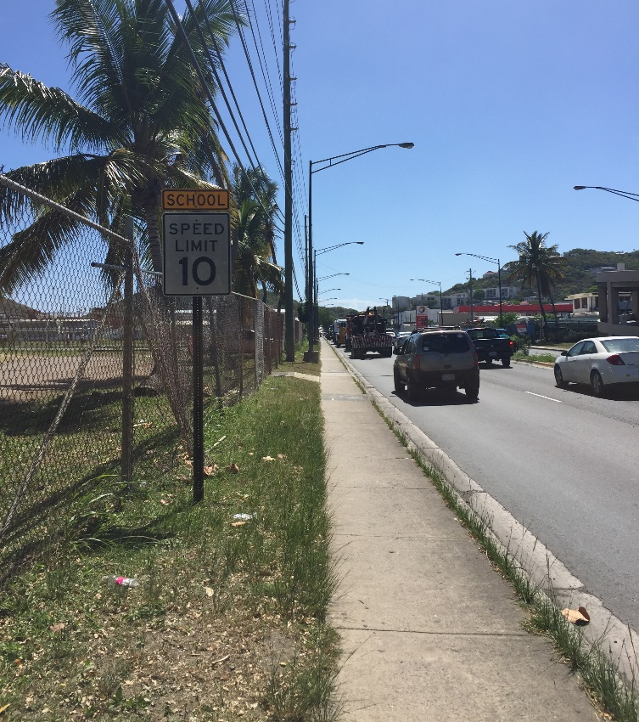
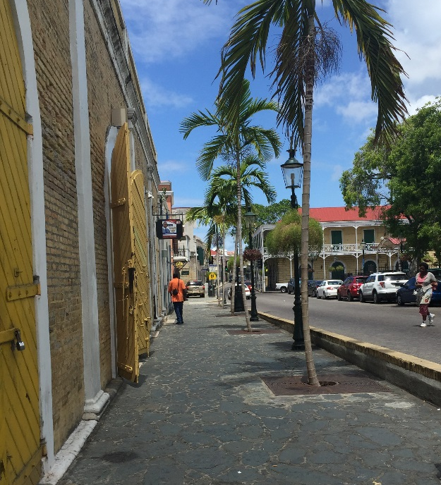
Street Lighting
None:
46.7%
Some:
50.8%
Ample:
2.4%

Slide 17
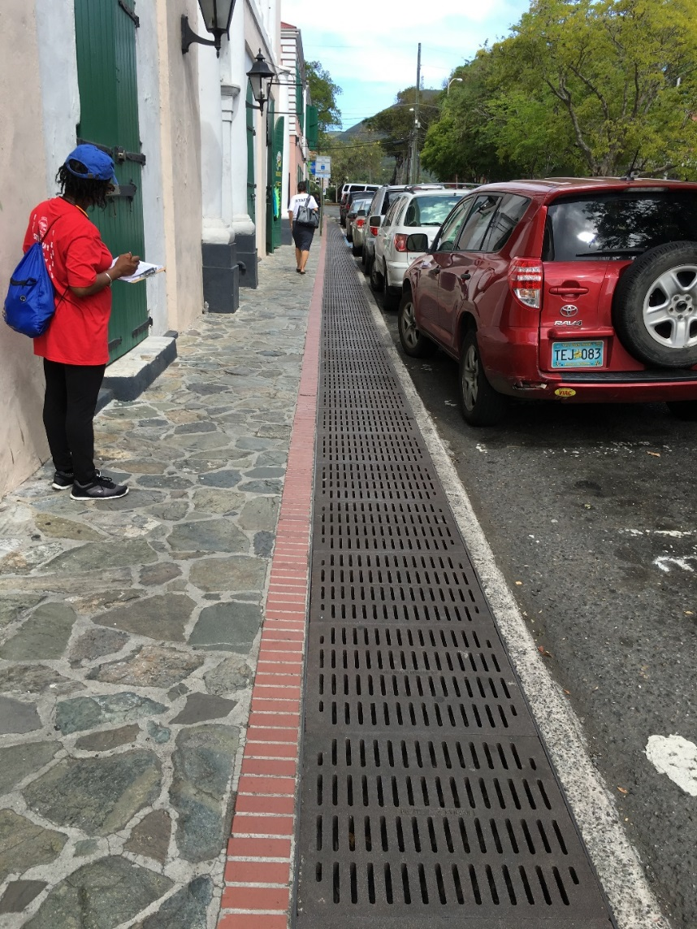
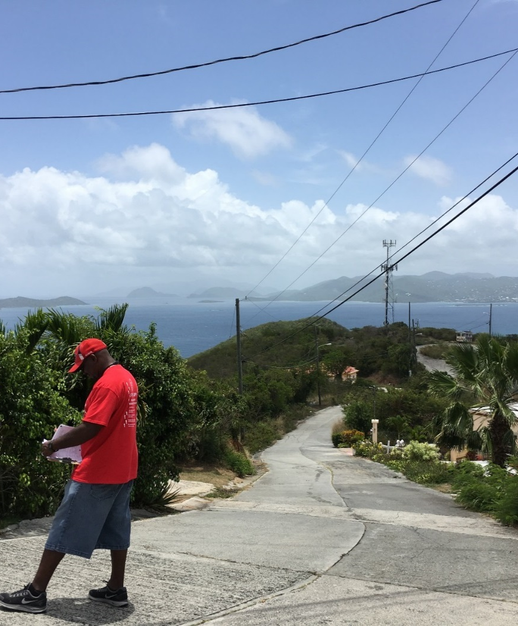
Presence of Sidewalks
Sidewalk:
11.4%
No sidewalk:
88.6%

Slide 18

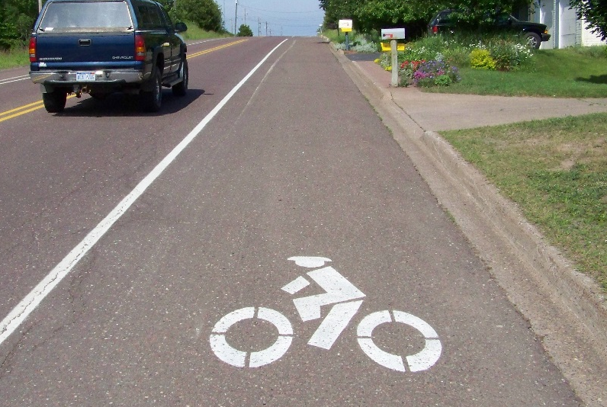

Bicycle Infrastructure
Bicycle lanes:
0.0%
Bicycle signage:
0.1%

Slide 19
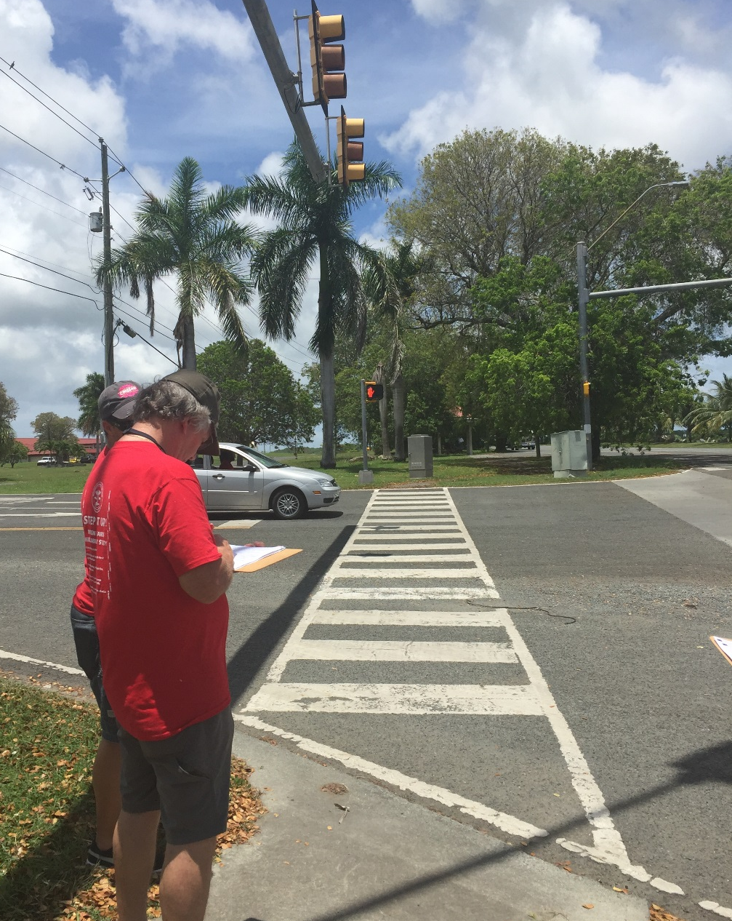
Crossings
Intersection control:
15.8%
Signalization:
2.7%
Marked crosswalks:
6.1%
Notes:
.

Slide 20


Step it Up! The Surgeon General’s
Call to Action to Promote Walking and Walkable Communities

Slide 21
Step it Up! The Surgeon General’s
Call to Action
Five Goals:
  Make walking a national priority
  Design communities that make it safe and easy to walk
  Promote programs and policies to support walking
  Provide information to encourage walking and improve walkability
  Fill surveillance, research, and evaluation gaps related to walking and walkability

Slide 22

Potential Action Steps
Make walking a territory priority
  Form an Active Living Coalition with local partners, including:
Government
Public Works
Parks & Recreation
Tourism
Education
Elected officials
Non-Profit/Volunteer
AARP
Advocacy groups
Other Sectors
Local businesses
Healthcare

Slide 23
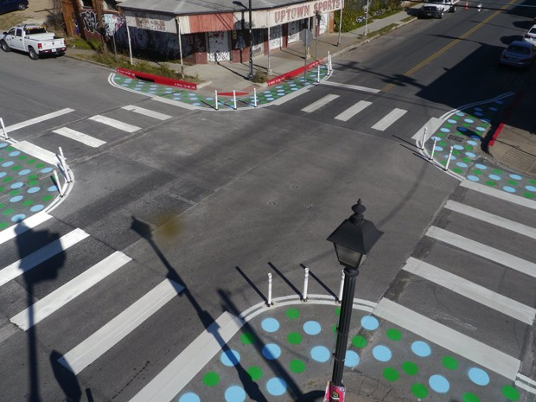
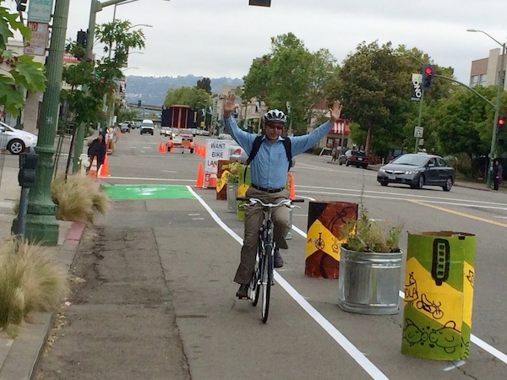
Potential Action Steps
Design communities that make it safe and easy to walk
  Identify priority areas and develop a Community Action Plan
  Design streets, sidewalks, and crosswalks that encourage walking for people of all ages and abilities
    Ex: pilot lighter, quicker, cheaper (LQC) projects in community
Austin, TX
Oakland, CA

Slide 24



Potential Action Steps
Design communities that make it safe and easy to walk
  Adopt or modify community planning, land use, transportation, development, and zoning policies and plans that support walking
Austin, TX
Oakland, CA

Slide 25
Potential Action Steps
Promote programs and policies to support walking
  Support community-based programs and policies
    Ex: Safe Routes to School
  Encourage safe and convenient access for all users to community locations that support walking
    Ex: walking trails, parks, recreational facilities, and college campuses
  Promote walking programs that address barriers

Slide 26



Potential Action Steps
Provide information to encourage walking and improve walkability
  Share findings with local partners
  Educate local professionals on how they can promote walkability
    Apply for additional opportunities for technical assistance

Slide 27
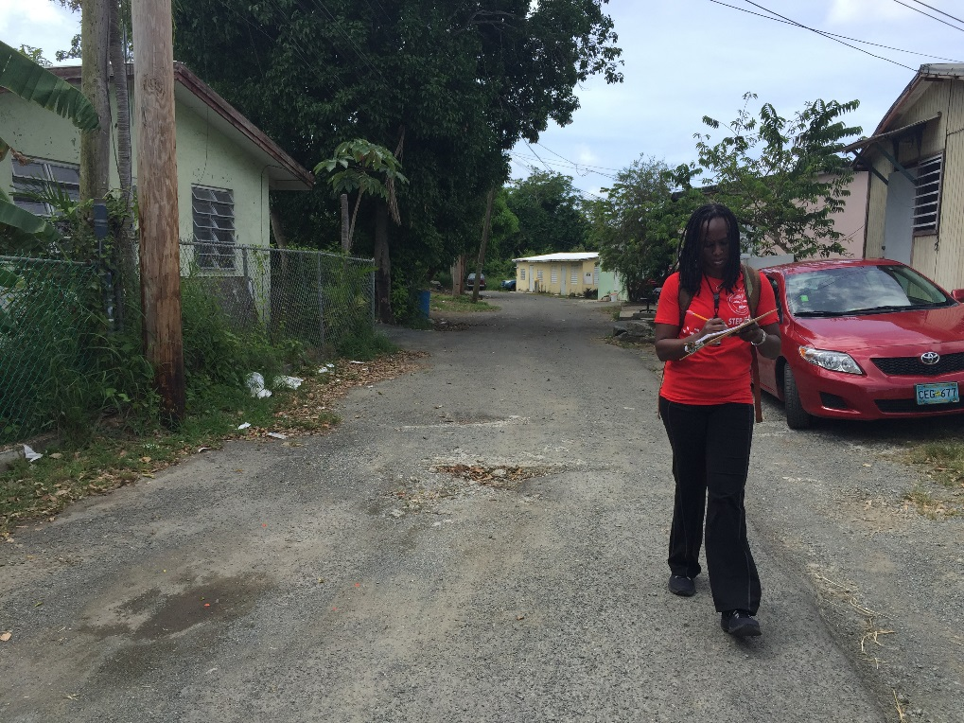
Potential Action Steps
Fill surveillance, research, and evaluation gaps
  Conduct ongoing surveillance of the built environment
  Evaluate future efforts to improve walkability

Slide 28

Acknowledgements
USVI Department of Health
Esther Ellis
Kathleen Arnold-Lewis
John Orr
Volunteer auditors
Active Living Research
Jim Sallis
Chad Spoon
CDC
John Omura
Lillianne Lewis
Susan Carlson
Janet Fulton
Prabasaj Paul
Erin Peterson
Emily Ussery
Kathy Watson
Geoffrey Whitfield

